Slide 1

Finance And Risk Analytics for Investor Portfolio Management
By
Taufeeq Fathima

Slide 2

Agenda
Objective
Background
Key Findings
Portfolio Combinations
Portfolio Recommendation
Appendix

Slide 3

Objective

Slide 4

Objective
To provide consultation to two different investors, Mr. Patrick Jyengar and Mr. Peter Jyengar based on their requirements and financial objectives.
Performing Analysis of stocks with respect to Market index and create Portfolios based on the Investor’s Persona.
Suggesting and justifying the best portfolio which matches the investors expectations

Slide 5
Background
Let’s dive in

Slide 6
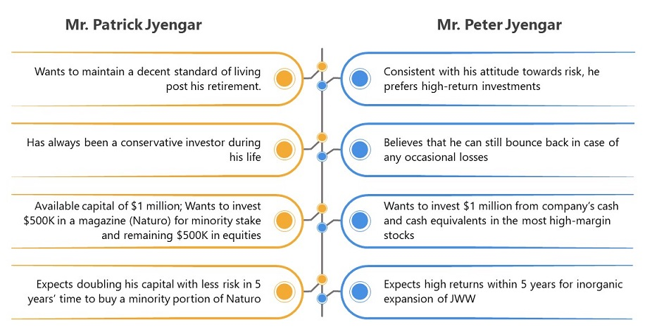
Background
Mr. Patrick Jyengar is owner of Jyengar Waterworks company. He wants to Retire in 5 years by doubling his investments in stocks.
Mr. Peter Jyengar is son of Mr. Patrick and wants an inorganic expansion of company by investing in stocks
We need to provide an investment strategy for them based on their Persona by analyzing the given 24 stocks.

Slide 7
Key Findings
Let’s dive in

Slide 8
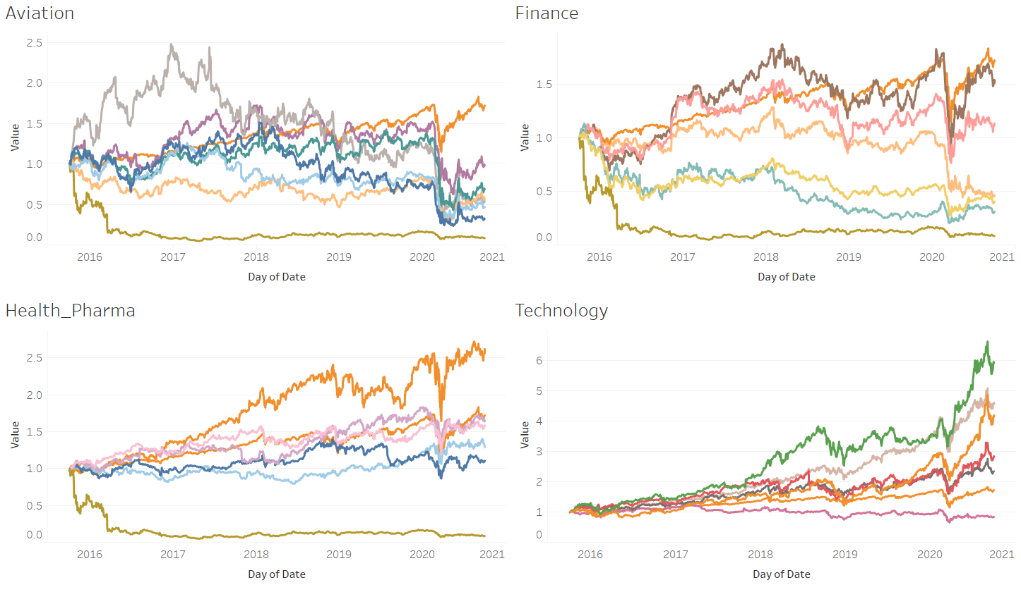
Key Findings – Sector Wise Analysis
From the graphs we can observe that Health care & Pharma Sector and Technology Sector are performing well in the Market.
There is an upward trend for those all sectors after March 2020. This might be because of the Global Pandemic which helped in the trend.
Aviation Sector is having downward trend over the last 5 years.
Finance sector has been moderate for the last 5 years.

Slide 9
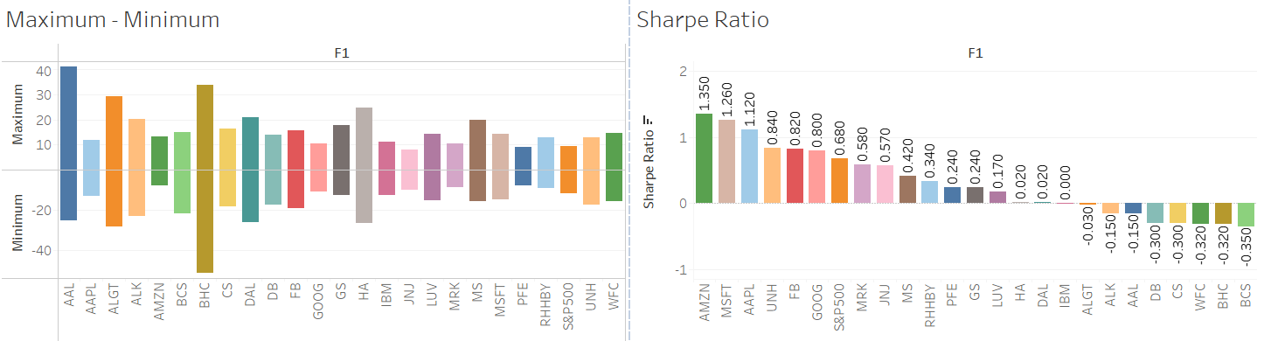
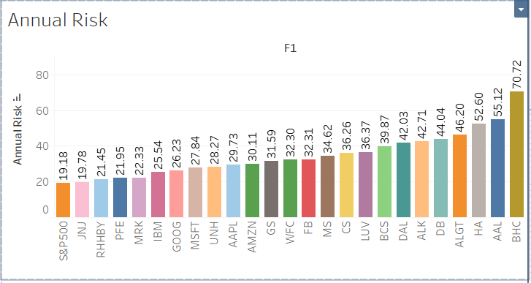
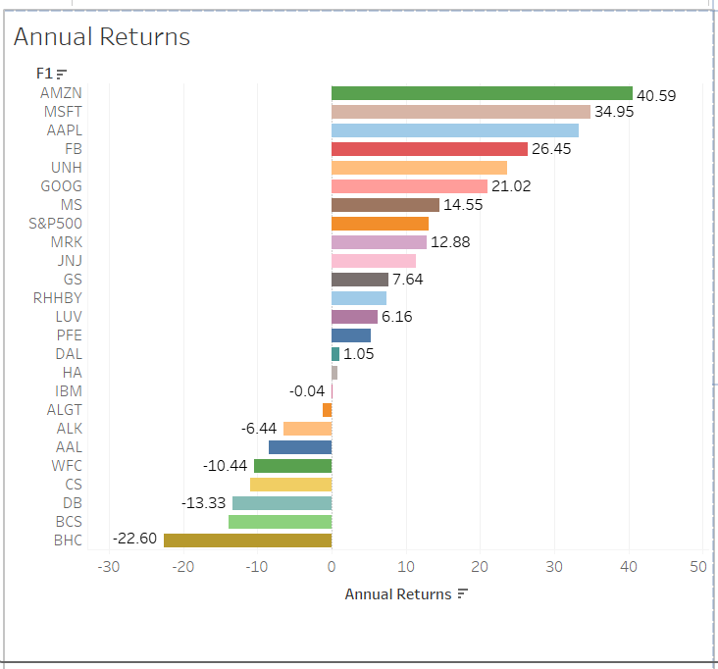
Key Findings - Metrics
From the Graph we can observe that Amazon(AMZN), Microsoft(MSFT) and Apple(AAPL) have higher Annual Returns and Sharpe Ratio.
This means that these are the high performing Stocks which will result in high Returns.
Most of the Pharma and Healthcare Stocks have low Annual Risk which is very close to the Market Index(19.18).
We can also observe 11 out of 24 stocks with negative returns. We will be excluding them as investors look for positive return Stocks.

Slide 10
Portfolio Combinations

Slide 11
Portfolio Combinations – Mr. Patrick Jyengar
Portfolios | Invested Amount | Invested Time | Stock Names | Portfolio Risk | Portfolio Return
Portfolio 1 | $500000 | 5 Years | 1. Johnson & Johnson(JNJ), 2. Merck and CO(MRK) 3. Roche Holding (RHHBY) 4. Amazon (AMZN) | 17.18 | $1143367.82
Portfolio 2 | $500000 | 5 Years | 1. Johnson & Johnson(JNJ), 2. Merck and CO(MRK) 3. Roche Holding (RHHBY) 4. Apple (AAPL) | 17.85 | $1038224.82
Portfolio 3 | $500000 | 5 Years | 1. Johnson & Johnson(JNJ), 2. Merck and CO(MRK) 3. Roche Holding (RHHBY) 4. Microsoft (MSFT) | 18.00 | $1058232.53
Note: Risk of Market Index S&P500 is 19.18

Slide 12
Portfolio Combinations – Mr. Peter Jyengar
Portfolios | Invested Amount | Invested Time | Stock Names | Portfolio Risk | Portfolio Return
Portfolio 1 | $1000000 | 5 Years | Amazon (AMZN) Microsoft (MSFT) | 26.52 | $5523971.81
Portfolio 2 | $1000000 | 5 Years | Amazon (AMZN) Microsoft (MSFT) Apple (AAPL) | 26.6 | $5201111.41

Slide 13
Portfolio Suggestions

Slide 14
Portfolio Recommendation
Investor | Invested Amount | Risk Type | Return Type | Stock Names | Portfolio Risk | Portfolio Return
Mr. Patrick Jyengar | $500000 | Low Risk | Double | 1. Johnson & Johnson(JNJ), 2. Merck and CO(MRK) 3. Roche Holding (RHHBY) 4. Amazon (AMZN) | 17.18 | $1143367.82
Mr. Peter Jyengar | $1000000 | Doesn’t Matter | High Returns | Amazon (AMZN) Microsoft (MSFT) | 26.6 | $5523971.81

Slide 15
Appendix

Slide 16
Appendix- Data sources
We are provided with the information for 24 stocks of leading companies listed in New York Stock Exchange(NYSE)
The information for every stock ranges from 1st October 2010 to 30th September 2020.
The stocks belong to different domains:
Technology/IT
Travel/Aviation/Hospitality
Banking/Financial Services and Insurance
Pharmaceuticals/Healthcare/Life Sciences
For Comparison with the market we are using the S&P 500 index prices as the benchmark.

Slide 17
Appendix- Data Methodology
We conducted technical analysis to understand the trend of the underlying stocks and calculated the metrics associated with risk and returns.
Using the metrics and the visualizations we compared the performance of the available securities against each other, and also against the market index, S&P500.
The findings were aligned with the investor persona to select the appropriate stocks for the portfolio.
After the selection of stocks, the portfolio was validated using the active investment strategy to estimate the prices in future.

Slide 18
Appendix - Assumptions
Technical analysis is limited to understanding the market movements to predict the future movement. So, the assumption for Technical Analysis is that History and the past trends will repeat.

Slide 19
Thank You

